Slide 1
Welcome

Slide 2
Our service today:
A short video
A reading from the Bible
Time for thinking and reflection
‘In Christ Along’
*
This service is suitable for all ages.

Slide 3
Then Jesus went with his disciples to a place called Gethsemane, and he said to them, “Sit here while I go over there and pray.” ³⁷ He took Peter and the two sons of Zebedee along with him, and he began to be sorrowful and troubled. ³⁸ Then he said to them, “My soul is overwhelmed with sorrow to the point of death. Stay here and keep watch with me.”
³⁹ Going a little farther, he fell with his face to the ground and prayed, “My Father, if it is possible, may this cup be taken from me. Yet not as I will, but as you will.”

Slide 4
⁴⁰ Then he returned to his disciples and found them sleeping. “Couldn’t you men keep watch with me for one hour?” he asked Peter. ⁴¹ “Watch and pray so that you will not fall into temptation. The spirit is willing, but the flesh is weak.”
⁴² He went away a second time and prayed, “My Father, if it is not possible for this cup to be taken away unless I drink it, may your will be done.”
⁴³ When he came back, he again found them sleeping, because their eyes were heavy. ⁴⁴ So he left them and went away once more and prayed the third time, saying the same thing.
⁴⁵ Then he returned to the disciples and said to them, “Are you still sleeping and resting? Look, the hour has come, and the Son of Man is delivered into the hands of sinners. ⁴⁶ Rise! Let us go! Here comes my betrayer!”

Slide 5
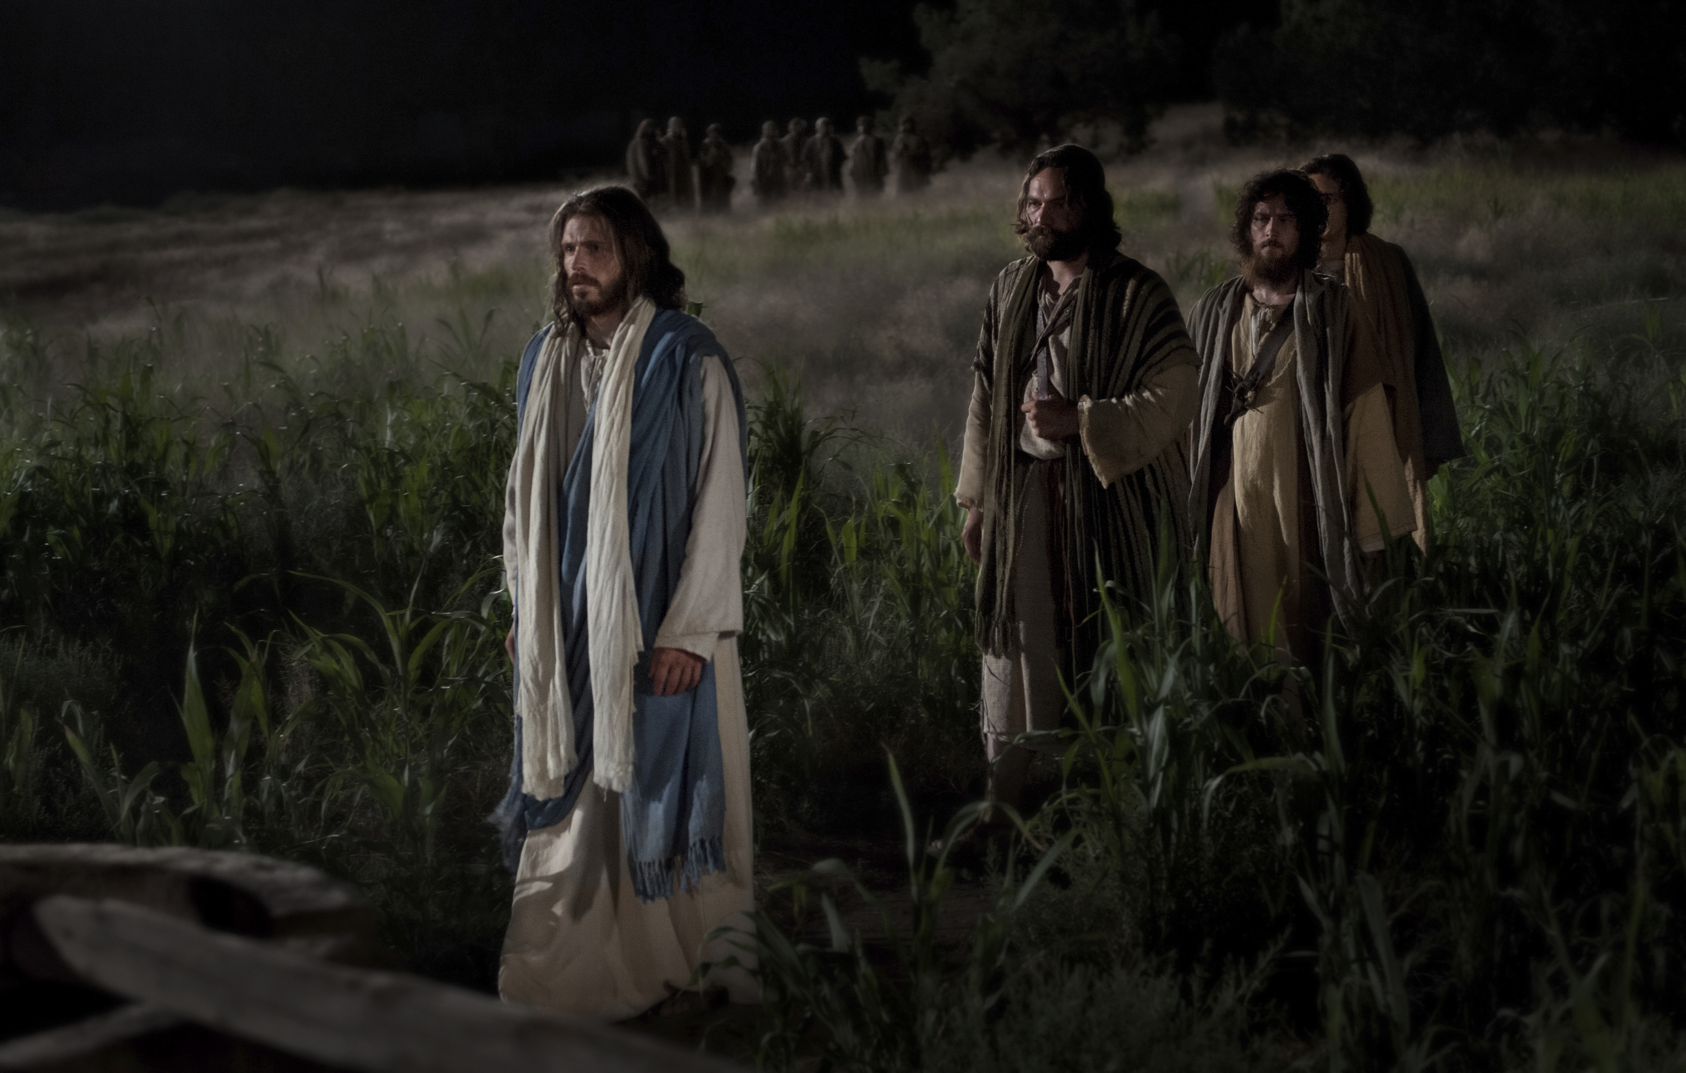
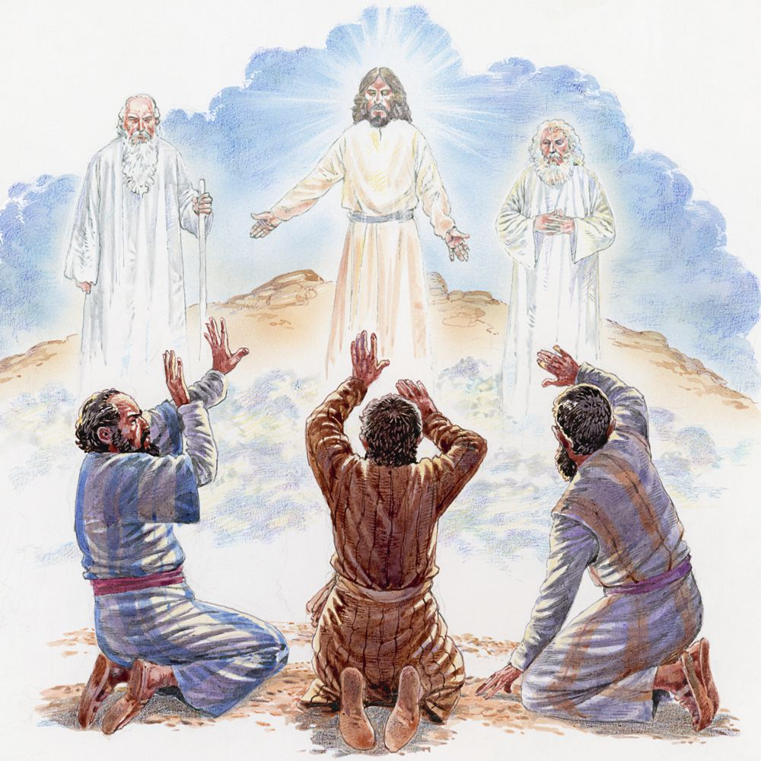

Slide 6
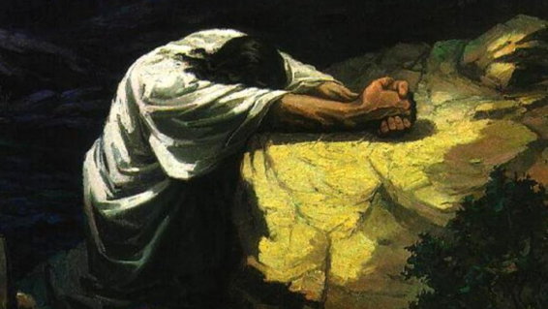

Slide 7
RED AND GREEN RIBBONS
What are some of the bad things that you see in the world and in your everyday life that cause you to feel sorrow and sadness?

Slide 8
In Christ alone my hope is found He is my light, my strength, my song This cornerstone, this solid ground Firm through the fiercest drought and storm

Slide 9
What heights of love, what depths of peace When fears are stilled, when strivings cease My comforter, my all in all Here in the love of Christ I stand

Slide 10
¹¹ Meanwhile Jesus stood before the governor, and the governor asked him, “Are you the king of the Jews?”
“You have said so,” Jesus replied.
¹² When he was accused by the chief priests and the elders, he gave no answer. ¹³ Then Pilate asked him, “Don’t you hear the testimony they are bringing against you?” ¹⁴ But Jesus made no reply, not even to a single charge—to the great amazement of the governor.
¹⁵ Now it was the governor’s custom at the festival to release a prisoner chosen by the crowd.

Slide 11
¹⁶ At that time they had a well-known prisoner whose name was Jesus Barabbas. ¹⁷ So when the crowd had gathered, Pilate asked them, “Which one do you want me to release to you: Jesus Barabbas, or Jesus who is called the Messiah?” ¹⁸ For he knew it was out of self-interest that they had handed Jesus over to him.
¹⁹ While Pilate was sitting on the judge’s seat, his wife sent him this message: “Don’t have anything to do with that innocent man, for I have suffered a great deal today in a dream because of him.”

Slide 12
²⁰ But the chief priests and the elders persuaded the crowd to ask for Barabbas and to have Jesus executed.
²¹ “Which of the two do you want me to release to you?” asked the governor.
“Barabbas,” they answered.
²² “What shall I do, then, with Jesus who is called the Messiah?” Pilate asked.
They all answered, “Crucify him!”
²³ “Why? What crime has he committed?” asked Pilate.
But they shouted all the louder, “Crucify him!”

Slide 13
²⁴ When Pilate saw that he was getting nowhere, but that instead an uproar was starting, he took water and washed his hands in front of the crowd. “I am innocent of this man’s blood,” he said. “It is your responsibility!”
²⁵ All the people answered, “His blood is on us and on our children!”
²⁶ Then he released Barabbas to them. But he had Jesus flogged, and handed him over to be crucified.

Slide 14
²⁷ Then the governor’s soldiers took Jesus into the Praetorium and gathered the whole company of soldiers around him. ²⁸ They stripped him and put a scarlet robe on him, ²⁹ and then twisted together a crown of thorns and set it on his head. They put a staff in his right hand. Then they knelt in front of him and mocked him. “Hail, king of the Jews!” they said. ³⁰ They spit on him, and took the staff and struck him on the head again and again. ³¹ After they had mocked him, they took off the robe and put his own clothes on him. Then they led him away to crucify him.

Slide 15
BLUE AND PURPLE RIBBONS
I wonder what disappointments are you wrestling with at the moment?

Slide 16
In Christ alone who took on flesh Fullness of God in helpless babe This gift of love and righteousness Scorned by the ones He came to save

Slide 17
Till on that cross as Jesus died The wrath of God was satisfied For every sin on Him was laid Here in the death of Christ I live

Slide 18
³² As they were going out, they met a man from Cyrene, named Simon, and they forced him to carry the cross. ³³ They came to a place called Golgotha (which means “the place of the skull”). ³⁴ There they offered Jesus wine to drink, mixed with gall; but after tasting it, he refused to drink it. ³⁵ When they had crucified him, they divided up his clothes by casting lots. ³⁶ And sitting down, they kept watch over him there. ³⁷ Above his head they placed the written charge against him:
this is jesus, the king of the jews.

Slide 19
³⁸ Two rebels were crucified with him, one on his right and one on his left. ³⁹ Those who passed by hurled insults at him, shaking their heads ⁴⁰ and saying, “You who are going to destroy the temple and build it in three days, save yourself! Come down from the cross, if you are the Son of God!” ⁴¹ In the same way the chief priests, the teachers of the law and the elders mocked him. ⁴² “He saved others,” they said, “but he can’t save himself! He’s the king of Israel! Let him come down now from the cross, and we will believe in him. ⁴³ He trusts in God. Let God rescue him now if he wants him, for he said, ‘I am the Son of God.’”

Slide 20
⁴⁴ In the same way the rebels who were crucified with him also heaped insults on him.
⁴⁵ From noon until three in the afternoon darkness came over all the land. ⁴⁶ About three in the afternoon Jesus cried out in a loud voice, “Eli, Eli,^{[a]} lema sabachthani?” (which means “My God, my God, why have you forsaken me?”).^{[b]}
⁴⁷ When some of those standing there heard this, they said, “He’s calling Elijah.”

Slide 21
⁴⁸ Immediately one of them ran and got a sponge. He filled it with wine vinegar, put it on a staff, and offered it to Jesus to drink. ⁴⁹ The rest said, “Now leave him alone. Let’s see if Elijah comes to save him.”
⁵⁰ And when Jesus had cried out again in a loud voice, he gave up his spirit.
⁵¹ At that moment the curtain of the temple was torn in two from top to bottom. The earth shook, the rocks split ⁵² and the tombs broke open. The bodies of many holy people who had died were raised to life.

Slide 22
⁵³ They came out of the tombs after Jesus’ resurrection and went into the holy city and appeared to many people.
⁵⁴ When the centurion and those with him who were guarding Jesus saw the earthquake and all that had happened, they were terrified, and exclaimed, “Surely he was the Son of God!”
⁵⁵ Many women were there, watching from a distance. They had followed Jesus from Galilee to care for his needs. ⁵⁶ Among them were Mary Magdalene, Mary the mother of James and Joseph, and the mother of Zebedee’s sons.

Slide 23
⁵⁷ As evening approached, there came a rich man from Arimathea, named Joseph, who had himself become a disciple of Jesus. ⁵⁸ Going to Pilate, he asked for Jesus’ body, and Pilate ordered that it be given to him. ⁵⁹ Joseph took the body, wrapped it in a clean linen cloth, ⁶⁰ and placed it in his own new tomb that he had cut out of the rock. He rolled a big stone in front of the entrance to the tomb and went away. ⁶¹ Mary Magdalene and the other Mary were sitting there opposite the tomb.

Slide 24
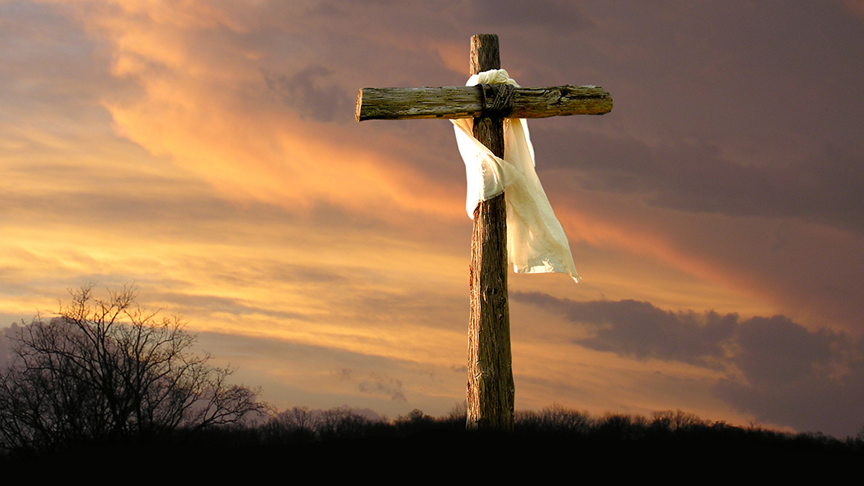
BLACK AND WHITE RIBBON
Look at the picture in the bag of the scene at the cross.
Imagine you are there.

Slide 25
Where would you have been standing? What would you have been saying?
You can even draw yourself in the picture.

Slide 26
There in the ground His body lay Light of the world by darkness slain Then bursting forth in glorious day Up from the grave He rose again

Slide 27
And as He stands in victory Sin's curse has lost its grip on me For I am His and He is mine Bought with the precious blood of Christ

Slide 28
No guilt in life, no fear in death This is the power of Christ in me From life's first cry to final breath Jesus commands my destiny

Slide 29
No power of hell, no scheme of man Can ever pluck me from His hand Till He returns or calls me home Here in the power of Christ I'll stand

Slide 30
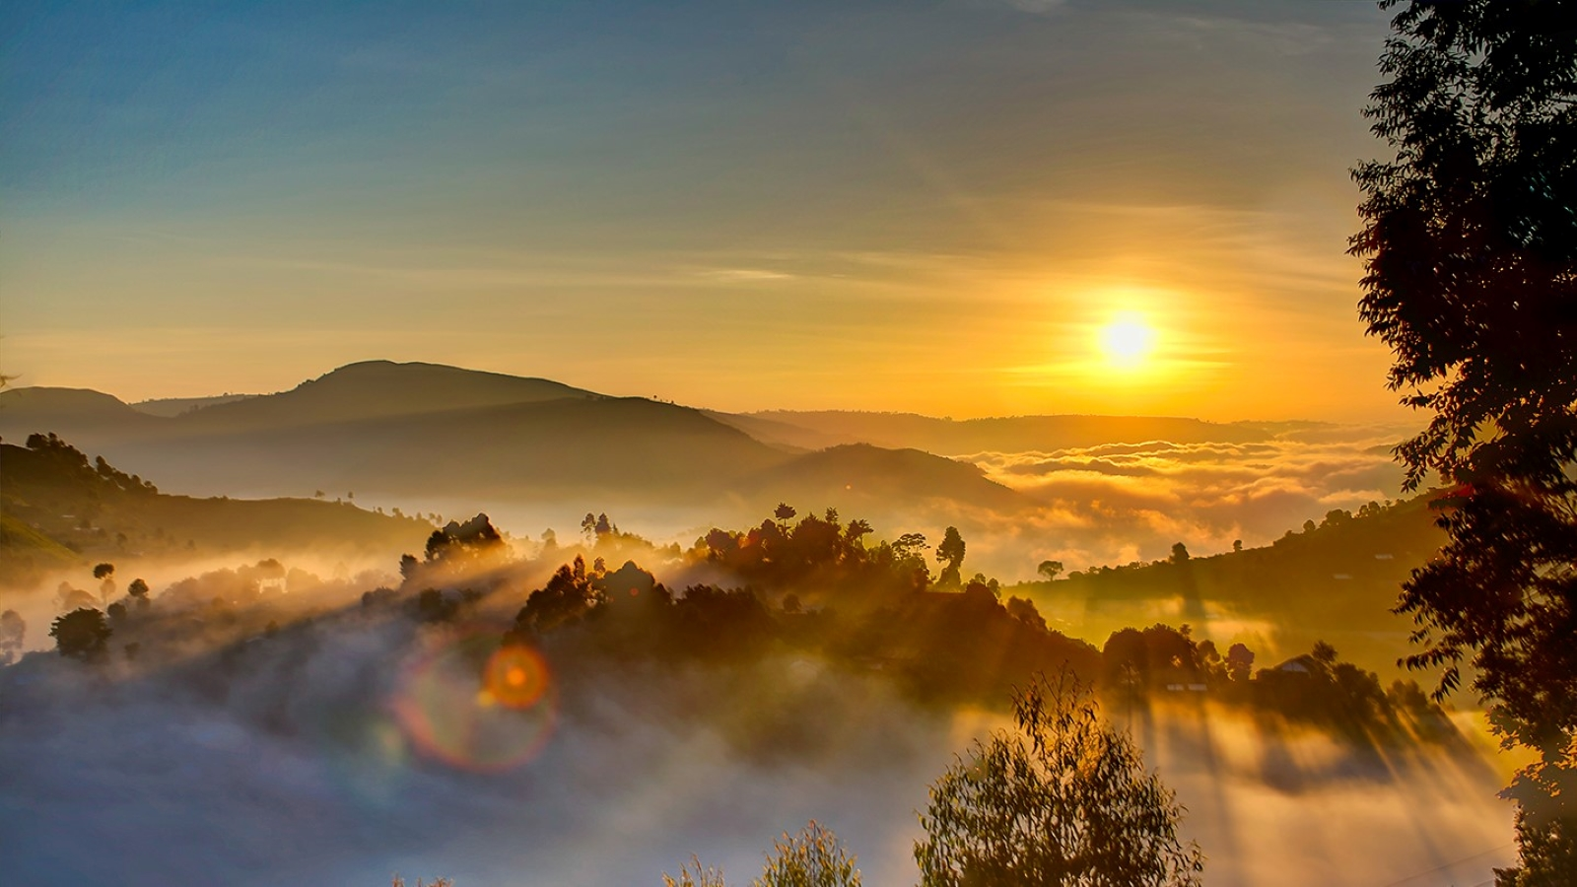
GOLD RIBBON

Slide 31
THANK YOU FOR COMING HAPPY EASTER!

